Slide 1
Fluid Mechanics (CHE F212)
Dr. SAROJ SUNDAR BARAL
Instructor-In-Charge

Slide 2
INTRODUCTION

Slide 3
Outline
Definition of a fluid
Fluid mechanics?
Scope/objectives of the course
Basic equations
Methods of analysis
Dimensions and units

Slide 4
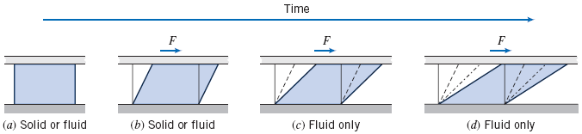

What is a fluid?
Stress (tensile, compressive and shear)
Solid vs fluid
When a shear stress is applied:
Solids deform or bend
Fluids continuously deform
Notes:
Fluids – Student’s perspective
Stress - Student’s perspective
Applied force/area
Tensile/Compressive (Pressure)/Shear
Shear stress
Solids
Permanently resist large amount of shear force/stress
They either deform or bend (elastic deformation)
Fluids
Cannot permanently resist a shear force
Once they start to move, it will keep on moving as long as some other force/stress is applied
Intermediate (Between solids and fluids) – e.g. peanut butter, jam, toothpaste, paste, etc.
- They behave like a fluid after applying a certain amount of shear stress.

Slide 5
Definition of a fluid
“Fluid is a substance that deforms continuously under the application of shear (tangential) stress no matter how small the shear stress may be”
Fluids → Liquids and gases (e.g. water and air)
No slip condition for fluid
Fluid in contact with solid surface does not slip
Fluid velocity will be same as solid surface velocity
Main characteristics of a fluid we are interested in
Velocity
Pressure
Notes:
Difference between liquids and gases
Based on intermolecular forces
Liquids can deform but cannot be compressed whereas gas can be compressed as well as deformed
No slip condition for fluid
Characteristics of fluid
- Velocity and pressure

Slide 6
Fluid mechanics ?
Mechanics
Study of forces and motions
Fluid mechanics
Fluid Statics (branch that deals with bodies at rest)
Stationary fluid (Pressure – Important characteristic)
Fluid Dynamics (branch that deals with bodies in motion)
Fluid in motion (Velocity, pressure – important)
One of the transport phenomenon
Driving force – Pressure difference
“Science that deals with the behaviour of fluids at rest or in motion, and interaction of fluids with solids or other fluids at the boundaries”
Notes:
Mechanics
Branch that deals with bodies at rest → Statics
Branch that deals with bodies in motion → Dynamics

Slide 7
Why to study fluid mechanics?
Majority of chemical engineering operations are conducted either partly or totally in the fluid phase
Reason for emphasis on fluid
At typical operating conditions, enormous number of materials exist as gases or liquids or can be transformed into these phases quite easily
More efficient and cost effective to work with fluids than solids
Applications
Industrial (energy, power plants, piping system)
Medical/Biomedical
Aerodynamics
Automobiles
Notes:
Applications
Hydraulics – flow of water in rivers, lakes, pipes, pumps
Aerodynamics – flow of air around air planes, rockets, etc.
Meteorology – flow of the atmosphere
Multiphase flow – oil wells, coffee percolators, combustion chambers, sprays

Slide 8
Scope and objectives of the course
Understanding basic principles, balance equations, fundamental concepts, and practical aspects related to fluid mechanics and fluid flow operations that a chemical engineer meets regularly.
“Introduction to the field of Fluid Mechanics to Chemical Engineers”
Handout (CHE F212)

Slide 9
Basic equations / principles
Conservation of mass
Newton’s second law of motion
The principle of angular momentum
The first law of thermodynamics
The second law of thermodynamics
Additional equations
Physical properties of fluid (e.g. Ideal gas law)
Can be used to solve mathematically for desired forces, velocities, etc. for simple flows
Need to rely on experiments to study complex flows

Slide 10
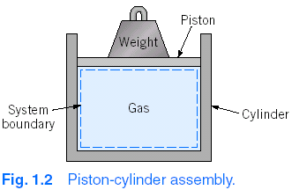
Methods of analysis
First step to solve a problem – To define a system (open or closed)
Fixed, identifiable quantity of mass
System boundaries
Separate system and surrounding, can be fixed or movable.
No mass crosses the system boundaries
System (or “Closed system”)
Notes:
Systems and control volume
Similar to closed and open systems in thermodynamics
In thermodynamics, focus was on energy while in fluid mechanics, it is forces and motions

Slide 11
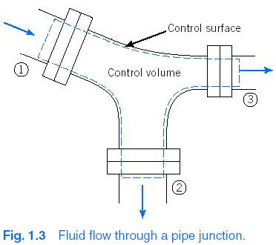
Method of analysis
Arbitrary volume in space
through which fluid flows
Boundaries (Control surface)
Can be real or imaginary
May be in rest or in motion
Control volume (or “Open system”)
Notes:
Choosing control volume has a big effect on the mathematical form of basic laws.

Slide 12
Differential vs Integral approach
Differential approach
Infinitesimal system or control volume
Resulting equations are differential equations
Helps to determine detailed behavior of the fluid flow
Integral approach
Finite system or control volume
Resulting equations are integral formulation
Used when information on gross behavior of the system is required (detailed knowledge of flow is not required
Dr. S.S. Baral
Notes:
Both approaches are important in the study of fluid mechanics

Slide 13
Methods of description
Lagrangian
Method of description that follows a particle (fixed, identifiable mass)
Eulerian
Method of description that focuses on the properties of a flow at a given point in space as a function of time

Slide 14
Dimensions and units
Dimensions
Physical quantities like length, mass, time, etc.
Primary and secondary quantities
Systems of dimensions
[M], [L], [t], and [T]
[F], [L], [t], and [T]
[F],[M], [L], [t], and [T]

Slide 15
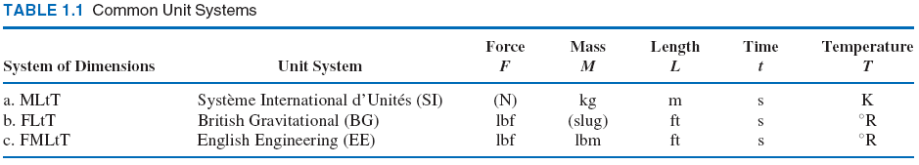
Dimensions and units
Systems of units
MLtT
SI (kg, m, s, K)
FLtT
British Gravitational (lbf, ft, s, ºR)
FMLtT
English Engineering (lbf, lbm, ft, s, ºR)

